Slide 1




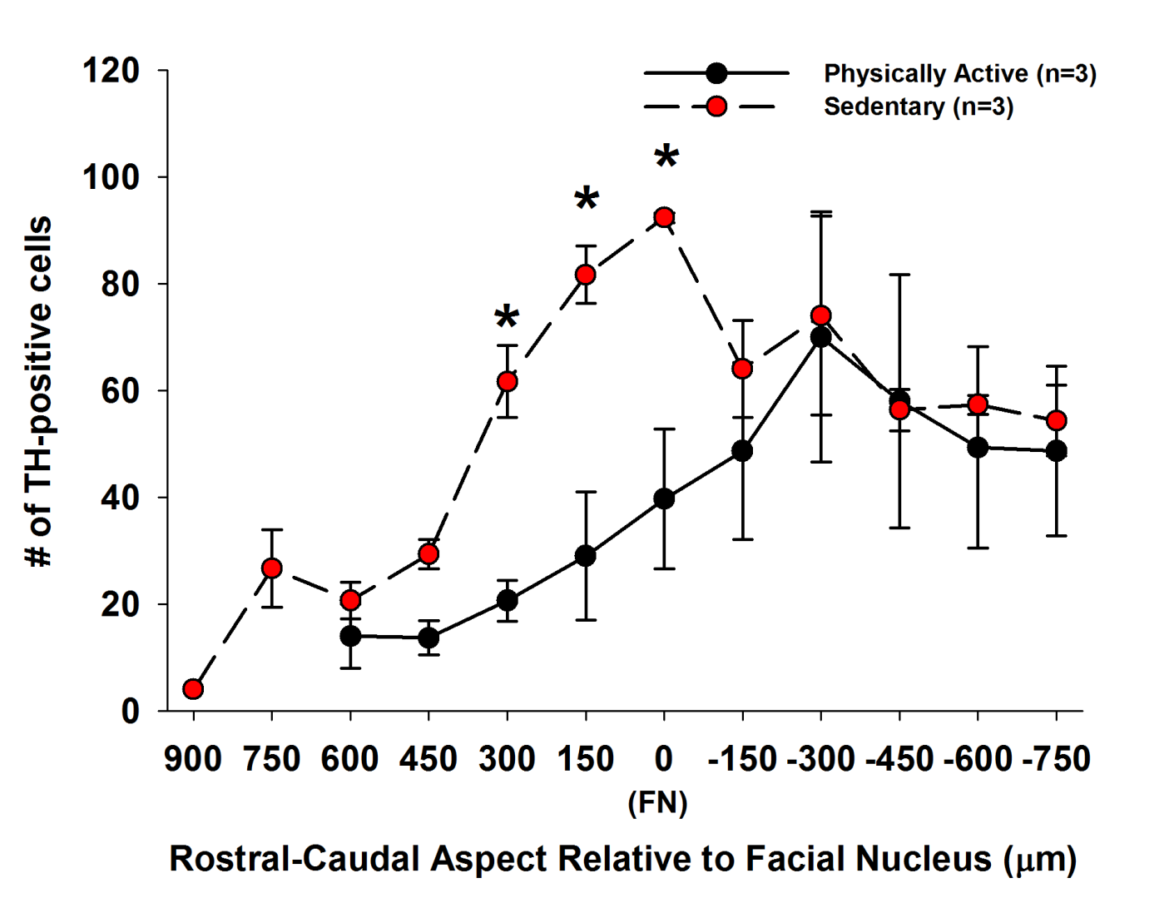
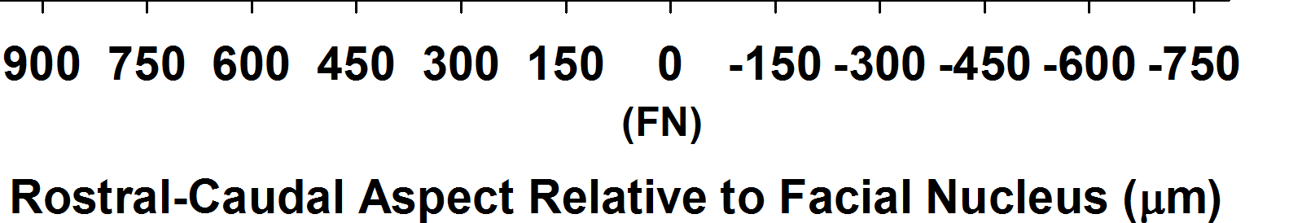
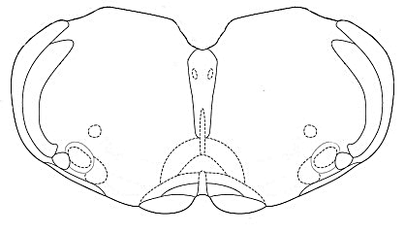
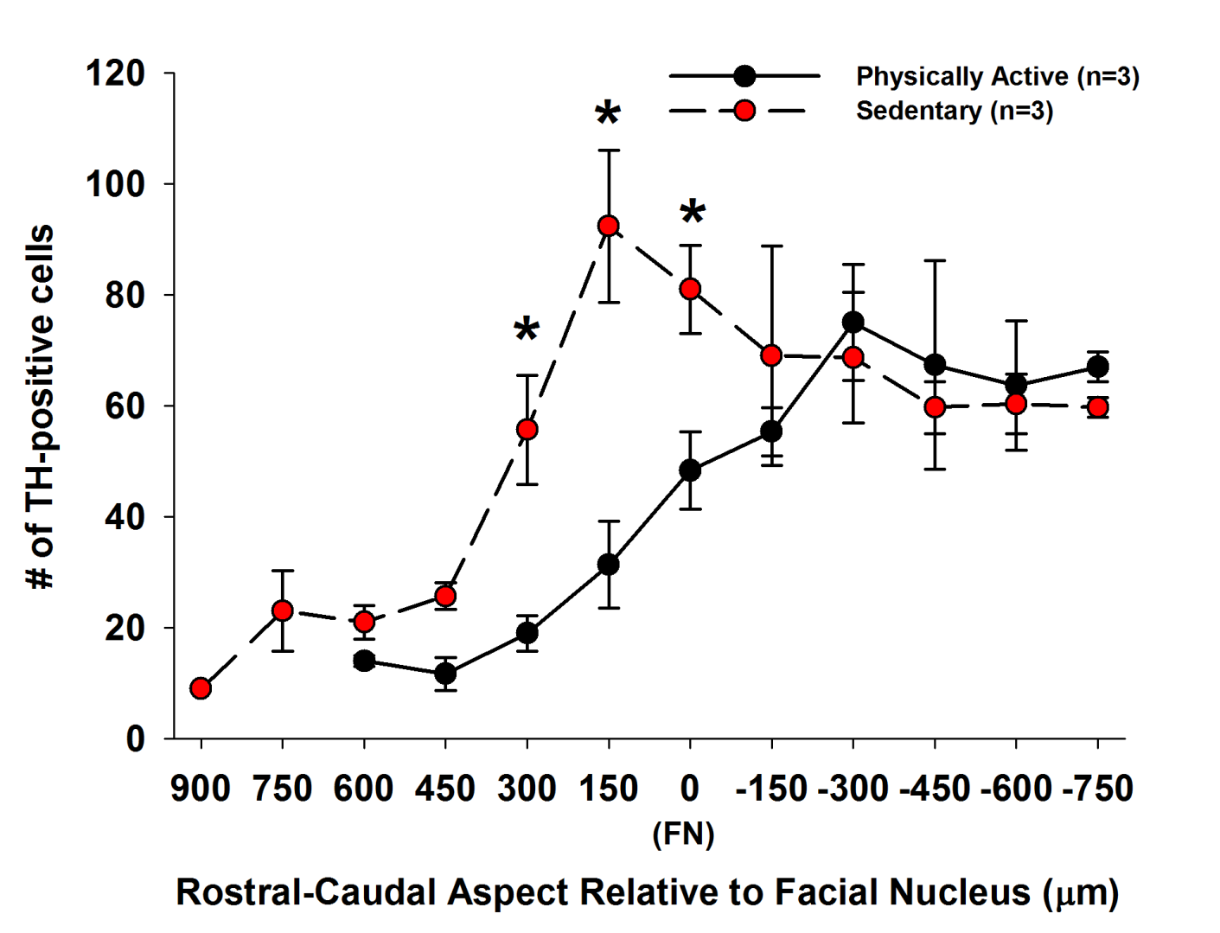
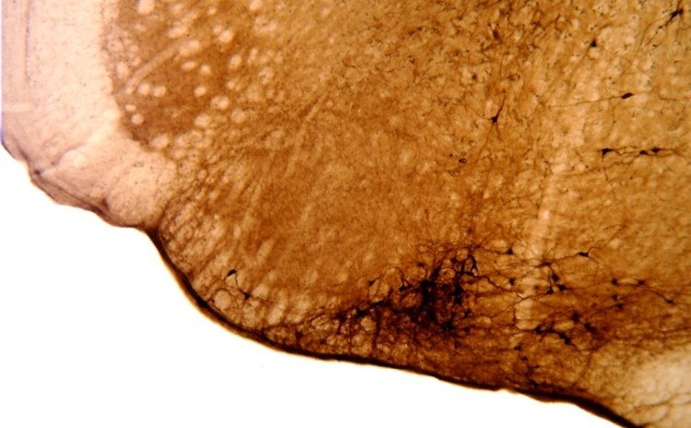

(1)Title Physical (in)activity leads to neuroplastic changes in the
rostral ventrolateral medulla (RVLM)
2) Author Line Susan L Speirs¹, Blah Blah,,,
3) Location Wayne State University School of Medicine, Detroit MI
²Centre for Neuroscience,
Introduction
The blah blah blah is involved in blah blah (Author lastname, 2006).
We and others have hypothesized that bblah blah blah (authorlastname 2010). For example, blah blah (Author lastname 2007). However, blah blah is unkown.
The majority of blah blah blah (Author lastname, 1997). One possible mechanism that could explain the blah blah blah is blah blah blah.
Therefore, the purpose of this project was to blah blah blah…
Methods
Model:
animal or computer or statistical or other.
describe model and parameters
Procedures unique to the study
Special techniques:
(Author last name, 2012)
Step by step possibly refer to picture
Additional process for gathering data:
step by step.
Results
Summary of Results
As expected from previous studies, blah blah blah.
In blah blah blah, more blahh blah blah blah blah blah blah were present in blah blah blah.
The numbers of blah blah blah were not different in the region blah blah blah.
A.
Conclusions
Based on their blah blah , blah blah changes in blah blah balh due blah blah blah conditions appear to be blah blah blah.
The blah blah blah observed may be due to a change in the blah blah blah that occur in blah blah blah
In addition to structural blah blah blah observed in other studies, blah blah blah may contribute to enhanced blah blah blah and risk of blah blah blah in people who blah blah blah.
7N
RVLM
Rationale
Picture or Cartoon of Methods
B.
An increase in blah blah may provide a blahh blah blah blah blah blah blah.
NA
SP5
Future Directions
Verify whether this pattern of blah blah blah versus blah blah blah includes blah blah blah.
Analyze blah blah blah distribution of blah blah blah to correlate with blah blah blah blah also being performed in our laboratory.
These studies are expected to further our understanding blah blah blah blah involved blah blah blah blah regulation and ultimately blah blah blah blah disease.
FN
Py
RVLM
Bregma – 12.00mm
Hypothesis
We hypothesize that blah blah blah have a greater blahh blah blah blah blah
blah blah compared
to blahh blah blah blah blah blah blah.
A.
B.
Lateral 2.1 mm
250 µm
References
Last name first initial. Title . Journal volume pages: 335-346, year.
Paxinos G, Watson C. The rat brain in stereotaxic coordinates. Burlington, MA: Elsevier Inc., 2007.
Figure 1. A. Describe figure. B. describe figure
Figure 2. Describe graph A and B and provide significance data
Acknowledgements
Special thanks to:
The American Physiological Society Frontiers In Physiology
for the opportunity to be a Teacher Researcher.
My mentor Dr. Patrick Mueller for extending his expertise and friendship.
The members of Mueller Lab (especially Nick Mischel)
for their technical expertise and encouragement.
Contact Information
susan.speirs@gpschools.org

